Slide 1
Lecture 7 Binary Logistic Regression
Faculty of Computer Science
Data Analysis
Moscow 2022
Lecturer: Alisa Melikyan, amelikyan@hse.ru, PhD,
Associate Professor of the School of Software Engineering

Slide 2
Logistic regression
Data Analysis
Lecture 7
Binary Regression
Logistic regression is a multiple regression with an outcome variable that is categorical and predictor variables that are continuous or categorical.
Predictors are continuous or categorical variables
Logistic Regression
Dependent variable is categorical

Slide 3

Binary Logistic Regression
Data Analysis
Lecture 7
Binary Regression
In binary logistic regression the dependent variable is dichotomous. So we can, for example, predict in which of two categories a person is likely to belong to given certain other information. Permits to evaluate the probability of presence/absence of some characteristic.
Source: https://www.youtube.com/watch?v=4UI9qZw7DXg

Slide 4
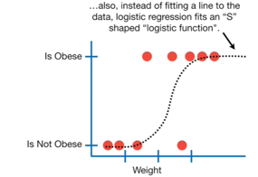
Binary Regression
Data Analysis
Lecture 7
Binary Regression
The curve goes from 0 to 1. The curve tells the probability that a person is obese or not based on the weight. The higher the weight the grater is a probability that the person is obese.
Source: https://www.youtube.com/watch?v=yIYKR4sgzI8

Slide 5
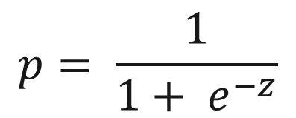
Probability of Y occurring
Data Analysis
Lecture 7
Binary Regression
In logistic regression, instead of predicting the value of a variable Y from predictor variables we predict the probability of Y occurring given known values of the predictor variables.
p – probability of Y occurring,
e – base of natural logarithms,
z = b₁*X₁ + b₂*Х₂ + ...+ b_{n} *X_{n} + a,
a – constant,
X₁, Х₂ ... X_{n} – regression coefficients.

Slide 6
Why can’t we apply linear regression?
Data Analysis
Lecture 7
Binary Regression
We can’t apply linear regression directly to a situation is which the outcome variable is dichotomous because one of the assumptions of linear regression is that the relationship between variables is linear.
In the binary logistic regression we transform the data using the logarithmic transformation. This has the effect of making the form of the relationship linear whilst leaving the relationship itself as non-linear. In the formula above we express the multiple linear regression equation in logarithmic terms.

Slide 7
Interpretation of the probability
Data Analysis
Lecture 7
Binary Regression
The resulting value from the equation is a probability value that varies between 0 and 1. It’s the probability of occurring an event that corresponds of the highest value of Y. A value close to 0 means that Y is very unlikely to have occurred, and a value close to 1 means that Y is very likely to have occurred. If the probability is less than 0,5 we will conclude that it’s unlikely that the event will occur.

Slide 8

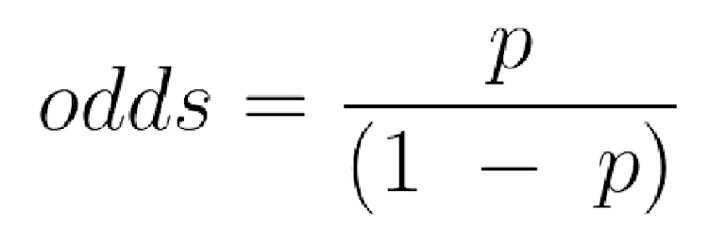
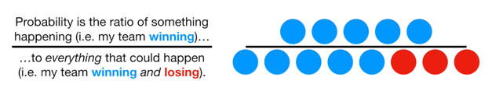
Odds and Probabilities
Data Analysis
Lecture 7
Binary Regression
Source: https://www.youtube.com/watch?v=ARfXDSkQf1Y

Slide 9
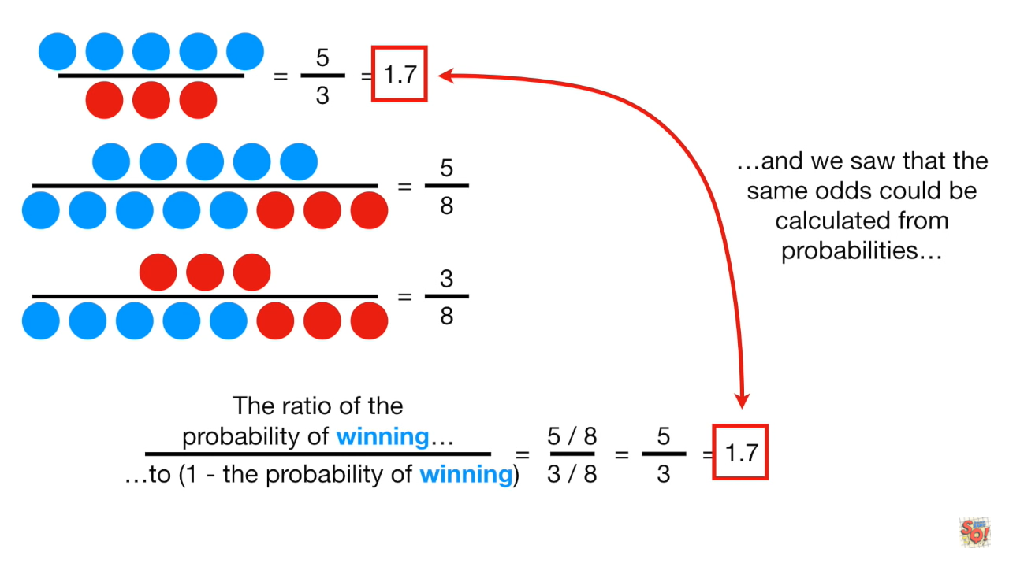
Odds and Probabilities
Data Analysis
Lecture 7
Binary Regression

Slide 10
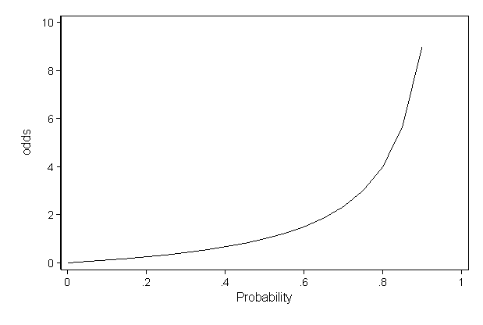
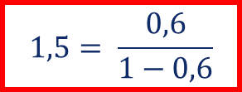
Odds and Probabilities
Data Analysis
Lecture 7
Binary Regression
Probability | 0,01 | 0,2 | 0,3 | 0,5 | 0,6
Odds | 0,0101 | 0,25 | 0,42 | 1 | 1,5

Slide 11
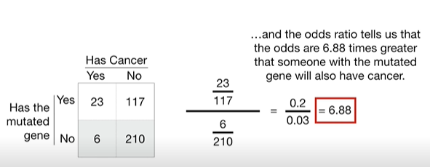
Odds ratio
Data Analysis
Lecture 7
Binary Regression
Source: https://www.youtube.com/watch?v=8nm0G-1uJzA

Slide 12
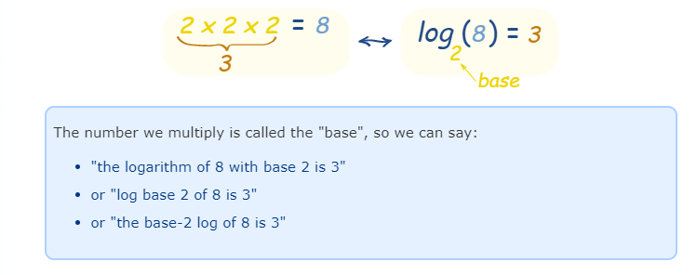
Logarithm
МАГОЛЕГО «Анализ данных»
Лекция 7
Бинарная регрессия

Slide 13
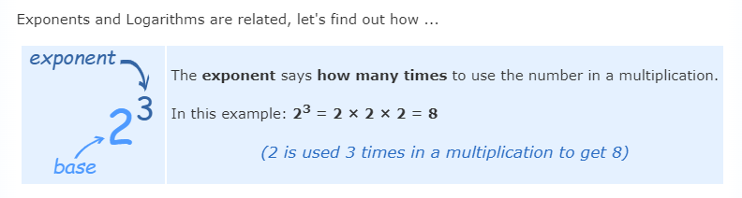
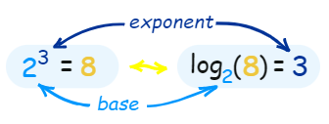
Exponent
МАГОЛЕГО «Анализ данных»
Лекция 7
Бинарная регрессия

Slide 14

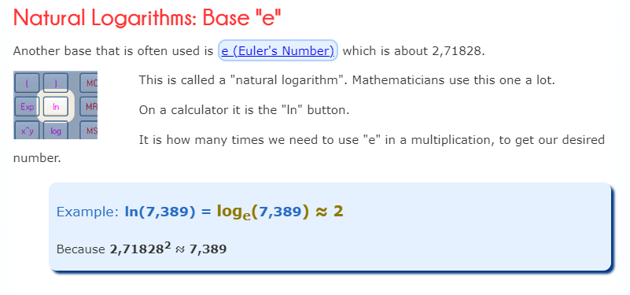
Natural Logarithm
МАГОЛЕГО «Анализ данных»
Лекция 7
Бинарная регрессия
Source: https://www.mathsisfun.com/algebra/logarithms.html

Slide 15
Ехр (В)
Data Analysis
Lecture 7
Binary Regression
Exp(B) is the exponentiation of the B coefficient, which is an odds ratio. Is an indicator of the change in odds resulting from a unit change in the predictor.
Dependent variable: the student has passed the exam or not.
Predictor variable: the student prepared for the exam or not.
The odds of passing the exam are the probability of passing the exam divided by the probability of not passing it.
To calculate the change in odds that results from a unit change in the predictor we first calculate the odds of passing the exam given that there was no preparation for it. Then we calculate the odds of passing the exam given that there was a preparation. Finally we calculate the proportionate change in these two odds.

Slide 16
Ехр (В): interpretation
Data Analysis
Lecture 7
Binary Regression
The value greater than 1 indicates that as the predictor increases, the odds of the outcome occurring increase.
The value less than 1 indicates that that as the predictor increases, the odds of the outcome occurring decrease.
The value equal to 1 indicates that that as the predictor changes, the odds of the outcome occurring will not change.

Slide 17
Interpretation if the B coefficient is positive
Data Analysis
Lecture 7
Binary Regression
Coef (b) | OR=exp(b) | Interpretation
> 0 | > 1 | Y – candidate gets the job (positive outcome/negative outcome) X₁ – candidate has higher education (yes/no) X₂ – candidate’s years of experience (number of years) Candidates with higher education in comparison to the candidates without higher education (reference group) are more likely to get the job (positive income). Exp(b1)=3.1 -> odds of getting a job for candidates with higher education are 3.1 times higher than for candidates without higher education.

Slide 18
Interpretation if the B coefficient is positive
Data Analysis
Lecture 7
Binary Regression
Coef (b) | OR=exp(b) | Interpretation
> 0 | > 1 | Y – candidate gets the job (positive outcome/negative outcome) X₁ – candidate has higher education (yes/no) X₂ – candidate’s years of experience (number of years) Increase in the years of candidate’s experience will increase the odds to get a job (positive income). Exp(b2)=1.6 -> one unit increase in the years of candidate’s experience will increase by 1.6 or by 60% the odds of a getting a job.

Slide 19
Interpretation if the B coefficient is zero
Data Analysis
Lecture 7
Binary Regression
Coef (b) | OR=exp(b) | Interpretation
= 0 | = 1 | Candidates with higher education and without higher education have the same odds to get the job (positive income). Changes in the years of candidate’s experience will not change the odds to get the job (positive income).

Slide 20
Interpretation if the B coefficient is negative
Data Analysis
Lecture 7
Binary Regression
Coef (b) | OR=exp(b) | Interpretation
< 0 | form 0 to 1 | Candidates with higher education in comparison to the candidates without higher education (reference group) are less likely to get the job (positive income). Exp(b1)=0.1 -> odds of getting a job for candidates with higher education are 90% lower than for candidates without higher education. Increase in the years of candidate’s experience will decrease the odds to get the job (positive income). Exp(b2)=0.6 -> one unit increase in the years of candidate’s experience will decrease by 40% the odds of a getting a job.

Slide 21
Which model is the best?
Data Analysis
Lecture 7
Binary Regression
The chosen model will be the one that, when values of the predictor variable are placed in it results in values of Y closest to the observed values.
So, the values of the parameters are estimated using the maximum-likelihood estimation, which selects coefficients that make the observed values most likely to have occurred.

Slide 22
Assessing the model
Data Analysis
Lecture 7
Binary Regression
In logistic regression we use the observed and predicted values to asses the fit of the model. The measure is called log-likelihood.
The log-likelihood is based on summing the probabilities associated with the predicted and actual outcomes. It’s analogous to the residual sum of squares in multiple regression in the sense that it’s an indicator of how much unexplained information there is after the model has been fitted.
So the larger the value of the log-likelihood, the more unexplained observations there are. The baseline model is the model with no predictors and has only the constant. There are several pseudo-R-squared to assess the goodness of fit.

Slide 23
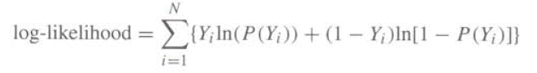

Log-likelihood
Data Analysis
Lecture 7
Binary Regression

Slide 24

Incomplete information
Data Analysis
Lecture 7
Binary Regression

Slide 25
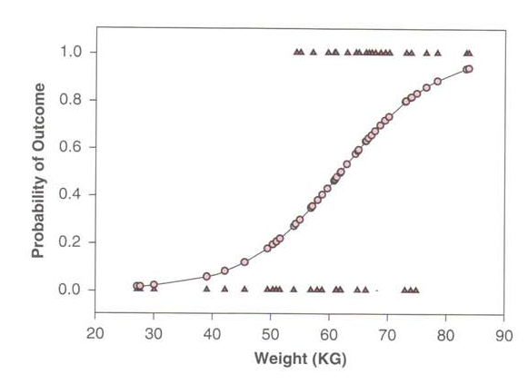
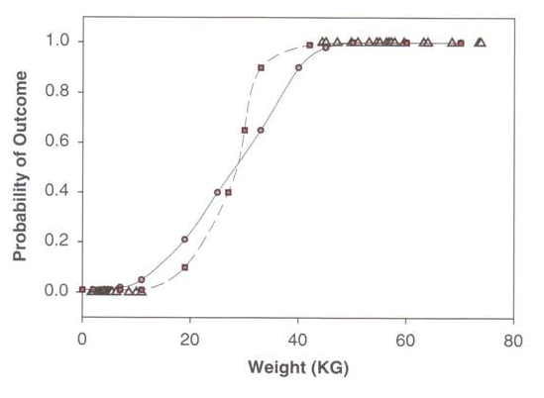
Complete separation
Data Analysis
Lecture 7
Binary Regression

Slide 26
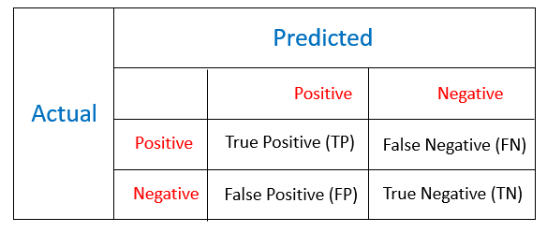
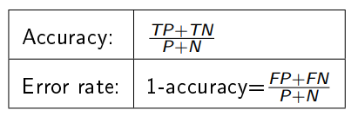
Confusion matrix
Data Analysis
Lecture 7
Binary Regression
P and N - number of observations of positive and negative class.
P = TP + FN, N = TN + FP

Slide 27
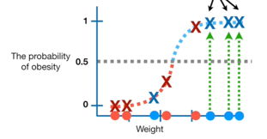
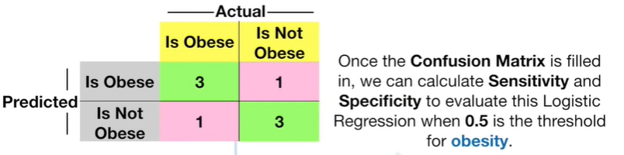
Confusion matrix with threshold 0.5
Data Analysis
Lecture 7
Binary Regression

Slide 28
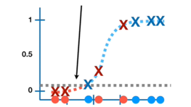
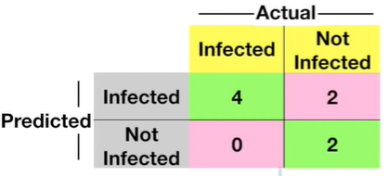
Confusion matrix with threshold 0.1
Data Analysis
Lecture 7
Binary Regression
Temperature

Slide 29
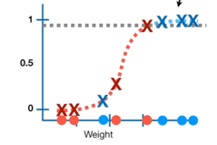
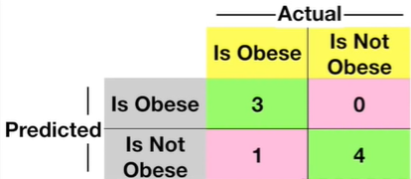
Confusion matrix with threshold 0.9
Data Analysis
Lecture 7
Binary Regression

Slide 30
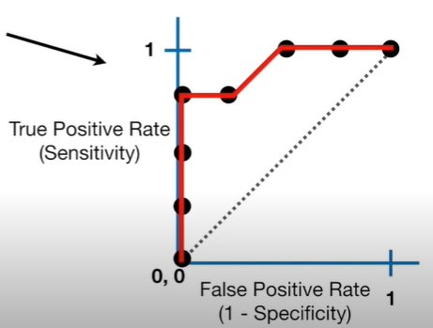
Confusion matrix with different thresholds
Data Analysis
Lecture 7
Binary Regression
The threshold could be set to anything between 0 and 1. If we made one confusion matrix for each threshold that matters, it would result in a large number of different confusion matrices. ROC graph helps to summarize all of the information.

Slide 31
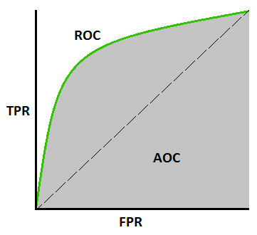
ROC-curve
Data Analysis
Lecture 7
Binary Regression
Receiver Operator Characteristic Curve – a graph that permits to evaluate the quality of the binary classification. It’s based on two values – True Positive Rate and False Positive Rate.
http://www.navan.name/roc/

Slide 32

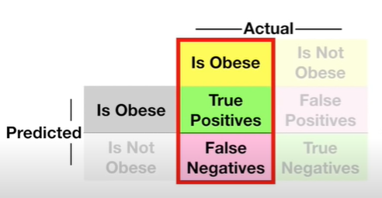
True Positive Rate
Data Analysis
Lecture 7
Binary Regression
True Positive Rate shows the proportion of cases with positive outcome (value 1), which were correctly classified.

Slide 33

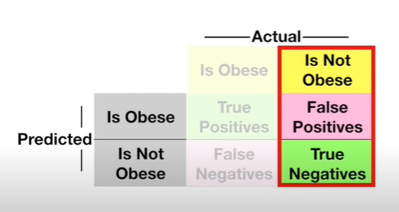
False Positive Rate
Data Analysis
Lecture 7
Binary Regression
False Positive Rate shows the proportion of cases with negative income (value 0), which were incorrectly classified.

Slide 34
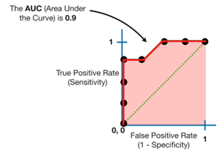
Area Under the Curve (AUC)
Data Analysis
Lecture 7
Binary Regression
Area under the curve helps to compare the quality of classifications and decide which categorization method is better.

Slide 35

Statistical significance of the model
Data Analysis
Lecture 7
Binary Regression
The model is significantly better (Prob <0.05) than the baseline model with no predictors. It means that by adding the predictors we managed to significantly decrease the log-likelihood (amount of unexplained information).

Slide 36

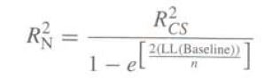
Pseudo R-squared
Data Analysis
Lecture 7
Binary Regression
Pseudo R-squared represents the percent of the variation of the dependent variable explained by the model.

Slide 37
Useful links
Data Analysis
Lecture 7
Binary Regression
http://www.dataschool.io/roc-curves-and-auc-explained/
https://stats.oarc.ucla.edu/other/mult-pkg/faq/general/faq-how-do-i-interpret-odds-ratios-in-logistic-regression/
https://www.youtube.com/watch?v=yIYKR4sgzI8
https://realpython.com/logistic-regression-python/

Slide 38
Thank you for your attention!
Faculty of Computer Science
Data Analysis
Moscow 2022

